Slide 1
MMT project
Team Frank and Charlie:
Raj (2020101049)
Supreeth (2020101021)

Slide 2
Overview of the project
First we tried to analyse the whole dataset to understand the correlations between the features.
Then we found that Energy, Valence, Danceability are important features correlated to Song Popularity
We tried to test the relationship between most dominant key of a song and its popularity by clustering all the songs into various clusters based on Energy and Valence.
Later based on the suggestions provided we found the outlier songs of various distributions and analysed them,

Slide 3
Dataset Description:
We have 954 Spotify Songs Data.
Songs that are most steamed from 1990-2023
Some Important Song Features in our dataset:
Danceability%,Valence%,
Key (Most dominant of the song),
Energy%,Acousticness%,Speechiness%,etc
Other important Dataset Features:
in_spotify_playlists : Number of playlists a particular song is added
in_spotify_charts: Number of times the song has appeared in the spotify charts
steams: Number of times the song is steamed on the platform

Slide 4
Methodology
Exploratory Data Analysis
Clustering and Analysis
Outliers detection and Analysis
EDA to understand data better and check how it is distributed
Cluster songs based on Valence and Energy to identify patterns between most dominant key and popularity
Detect outliers in our distributed and find its properties

Slide 5
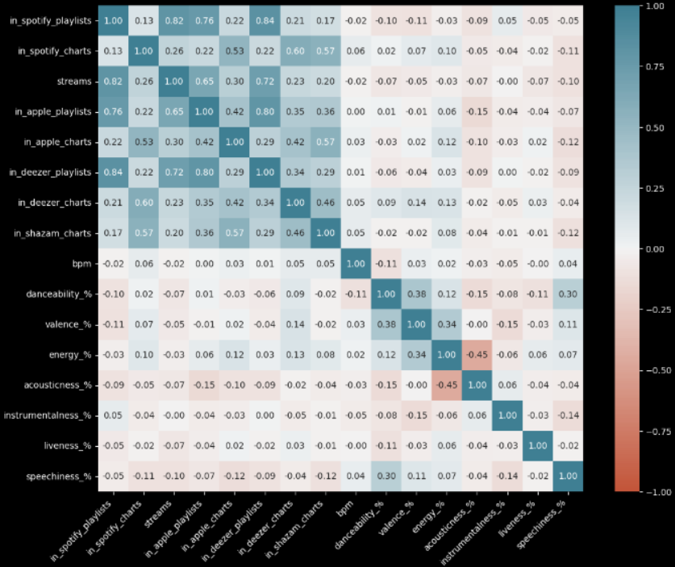
Feature Analysis
Correlation matrix helps us understand relationship b/w various features of a song.
As our distributions are not normal,we have used Spearman correlations.

Slide 6
Observations
As expected Energy and Acousticness have high negative correlation between them
Similar to in_spotify_playlists,charts, there are similar attributes of different platforms such as Apple,Deezer,Shazam. But we can clearly observe that the in_spotify features are highly correlated with the others,hence in the popularity estimation,we are going to compare based on in_spotify attributes only.
Valence, Energy,Danceability show relatively higher correlations to the popularity of the song when compared to other attributes like speechiness,liveliness,etc

Slide 7
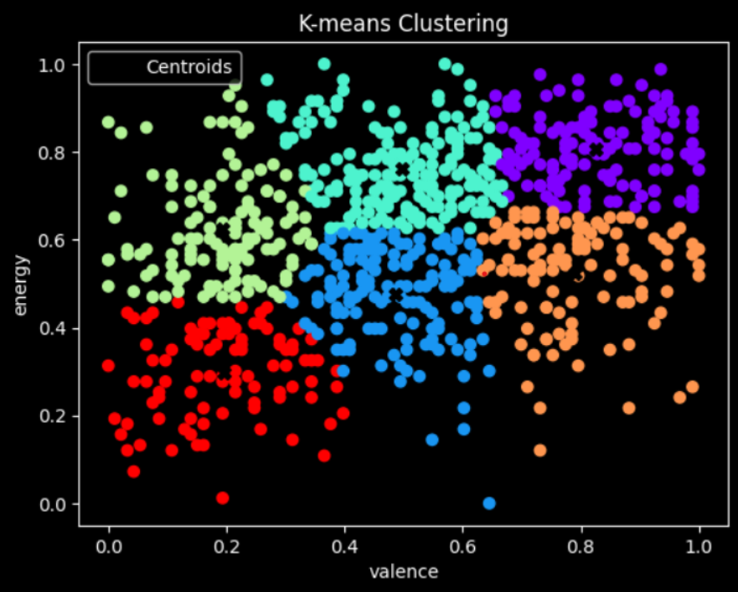
Clustering
Since the features Energy and Valence are the main attributes,we are going to cluster our data based on these 2 features.We have got 6 clusters with different distributions between energy and valence among them.

Slide 8
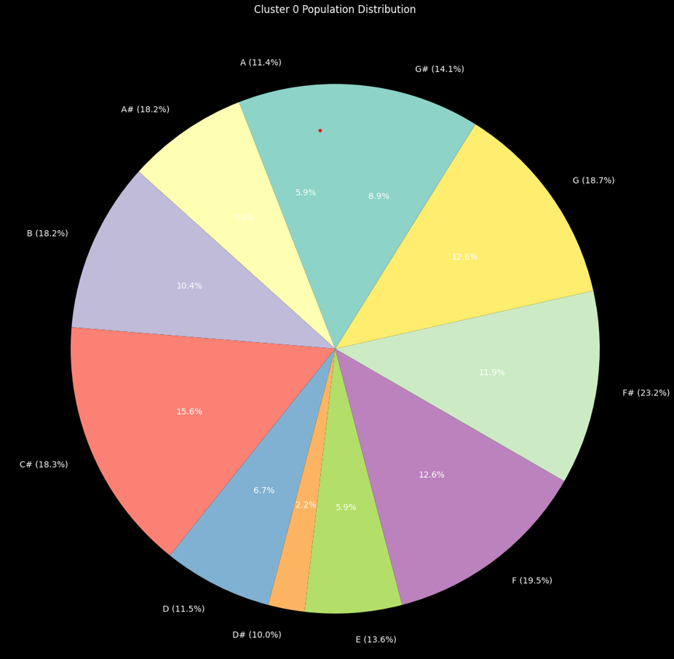
Observations of Key Distributions over clusters:
In most of the clusters, a large portion of the cluster is dominated by C# and a very least representation of D# .
In cluster 5 of low valence and relatively low energy has the least representation of C# (most popular songs in C# are at least moderately valent or moderately energetic).
In cluster 1 of medium valence and medium energy, there is relatively equal distribution of representation of various keys.
In cluster 2 of high energy,medium valence, there is a very large representation of both C# and G# (around 55%) and this cluster has songs of very large average steam count when compared to different clusters.

Slide 9
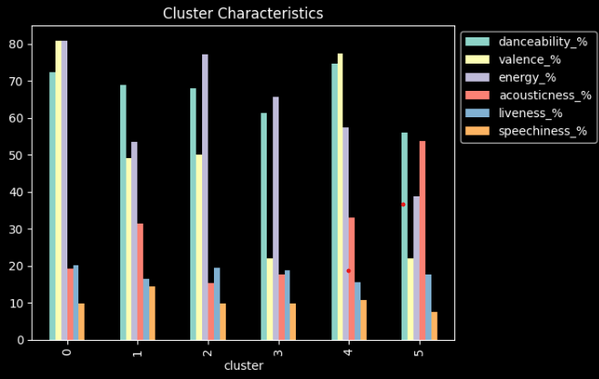
Distribution of various attributes across the clusters

Slide 10
Outliers in the distribution:
As we have already seen that Energy, Valence and Danceability are important features,we are going to analyze the outliers of the data with respect to distribution of these features.
Since they are skewed distributions, their outliers are detected with IQR Based Filtering.
Over all the popular songs dataset, we have found the following outliers:
Heart To Heart by Mac DeMarco - Energy Distribution
The Christmas song -Remastered by Nat King Cole - Energy Distribution
White Christmas by Bing Crosby - Danceability Distribution

Slide 11
Understanding the Outliers:
"Heart To Heart" by Mac DeMarco may be an outlier in energy due to its mellow and laid-back musical style, characterized by slower tempos and softer instrumentation.
"The Christmas Song - Remastered" by Nat King Cole could be an outlier in energy because it's a classic Christmas song known for its soothing and nostalgic atmosphere, often associated with calm and reflective moments during the holiday season.Similar is the nature of the song White Christmas by Bing Crosby.
The main reason for the popularity of the song "Heart to Heart" can be attributed to various social media platforms like TikTok, where the song has trended. The recommendation system played a key role in promoting the song and contributing to its trendiness.

Slide 12
Qualitative Analysis
A survey collecting data regarding :
Demographic details,
Current Mood Test (there are no definitive results from this section,almost all people are moderately happy)
Their response to listening to various attributes of the outlier song such as : Energy,Valence,Danceability,Song lyrics,Familiarity with the song or the artist,
We have collected data from 28 participants till now.

Slide 13
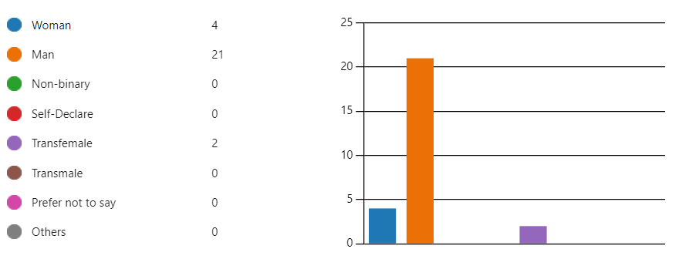
Participants Profiles:
We have data from following distribution of participants:
We could only be able to collect data from the participants
in the age group of 19-22.
Most of the participants have not been diagnosed with any
hearing condition and none of them have any hearing aids or
cochlear implants to assist them in hearing.

Slide 14
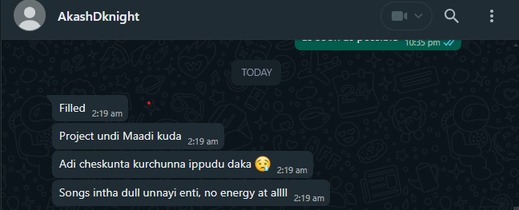
Understanding the survey data:
We have recorded how energetic participants perceive the overall vibe of songs, and we have an average rating of 4.93 for "Heart to Heart" (although we expected an even lower rating as this song is an outlier).
Despite the below-average rating, we have
received complaints about the song being dull and less
energetic, supporting them as outliers :)
The majority have felt love and affection after
listening to "Heart to Heart" lyrics, confirming our
understanding.

Slide 15
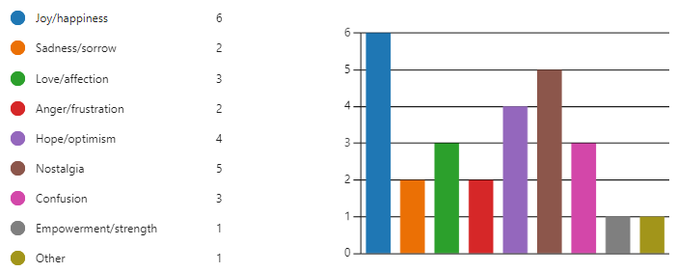
Understanding the survey data:
The majority have felt joy and nostalgia after
listening to the songs 'White Christmas' and
'The Christmas Song' by Nat Cole.
We have average danceability ratings of 4 and 4.7
for these songs, which proves them to be outliers to some
extent but is not strong proof :(
There are significant number of people who felt
Sadness/sorrow after listening to the song
White Christmas (which cannot be understood from our previous analysis).

Slide 16
Conclusions and Drawbacks:
The sample size (number of participants) is very low (28), and they belong to the 19-22 age group from India. Additionally, the majority of them aren't familiar with the artists or the songs. Hence, the findings aren’t very generalizable.
However, from our overall analysis and the data collected, we can conclude that a song's popularity is not solely determined by its energy, danceability, or the key dominant in a song, but rather by numerous other factors.
For instance, evoking a specific emotion in people during a particular period, such as the Christmas season, as seen with the song "The Christmas Song". Additionally, songs like "Mind to Mind" can resonate with listeners on a personal level, as they connect with the lyrics, often sharing them through social media platforms. Moreover, the familiarity of the artist to the audience can also significantly impact a song's popularity.

